Slide 1
Topic models
What’s in your sock drawer?

Slide 2
Four questions we’ll answer
What is unsupervised topic modeling?
What is it good for?
What have we (and others) used it for?
What else could we (or you) do with it?

Slide 3
An important new tool
A tool for discovering major topics in large collections of documents
think: lots of cases, Congressional committee prints, grey literature
Rose to prominence in digital humanities, especially history
Part of a set of law-and-computation technologies that everyone needs to know

Slide 4
In other words:
It does your skimming for you.
It will sort hay into haystacks.
It will not find the needle.

Slide 5
What is it? ….the basics
Assume that a document collection represents a discourse…
… and that the discourse contains a number of “topics”
For this purpose, a “topic” is a cluster of commonly-associated keywords
Guess the number of topics, and use fancy math to find the clusters

Slide 6
What is it? … in pictures
Notes:
layman’s explanation: highlight-and-collect
how to do this with a dumb machine
assume that the document is something that has been generated using words associated with a fixed number of topics (eg. typing monkeys who are slightly under the influence of a system of topics)
so, there’s some probability that any particular word is generated from topic X
in effect, the algorithm takes successively refined guesses at which topic generates which words
eventually, a good fit is discovered using these heuristics, which results in a statistical model
this statistical model can be used for inference.

Slide 7
What is topic modeling good for?
Finding out what’s in a big collection of documents.
Comparing discourse/topics between collections or between temporal snapshots
Lots of really weird stuff
identifying 19th C. trade routes
finding narrative patterns in IRS written responses

Slide 8
What’s it look like?
MALLET software (our tool of choice) creates 3 or 4 files
Easiest way to understand the model is via the keyword file
Here’s a labeled version

Slide 9
How do you make one?
Choose a corpus.
Pick a number of topics (usually 100)
Run
Tune stopwording
Increase number of topics
Lather, rinse, repeat
Label the model

Slide 10
Preprocessing
Terminology extraction
collateral vs. collateral estoppel vs. estoppel
eg. adding war-crimes cases to debtor/creditor
Stemming, lemmatization
Normalization of terms
Stopwording
tends to be labor intensive

Slide 11
Stopwording
Discourse filtering
eg in caselaw, substantive topics vs. jurisdiction/geography
eg in most legal materials, procedure vs everything else
Suppression of low-value (common) terms
Plus the algorithm just derails every now and then.

Slide 12
How to know when you’re done
This is more like cookery than math
We look for
topical coherence
right granularity of overall system of topics discovered
<10% junk topics
Tuning and labeling can readily be done by a research assistant/law student.

Slide 13
Streamlining model development
It’s early days for tools: still too project-specific and not well maintained
Text files and spreadsheets
Visualization for data exploration
stopword tuning
stemming, phrasing decisions
model sizing
gauging temporal stability of the model

Slide 14
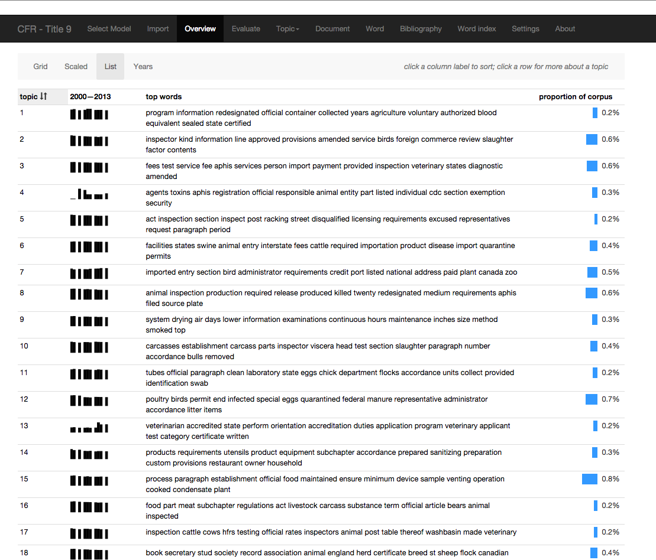
Visualizer: topic list
Notes:
development of topics over time

Slide 15
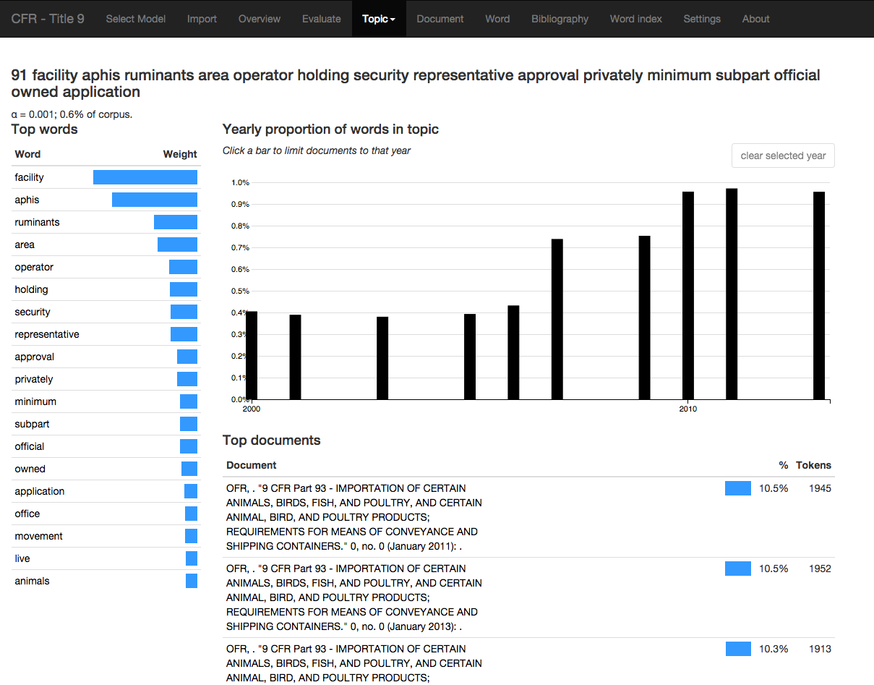
Visualizer: topic view
Notes:
Which documents are about this topic? How does this topic develop over time? What are the prominent tokens for this topic?

Slide 16
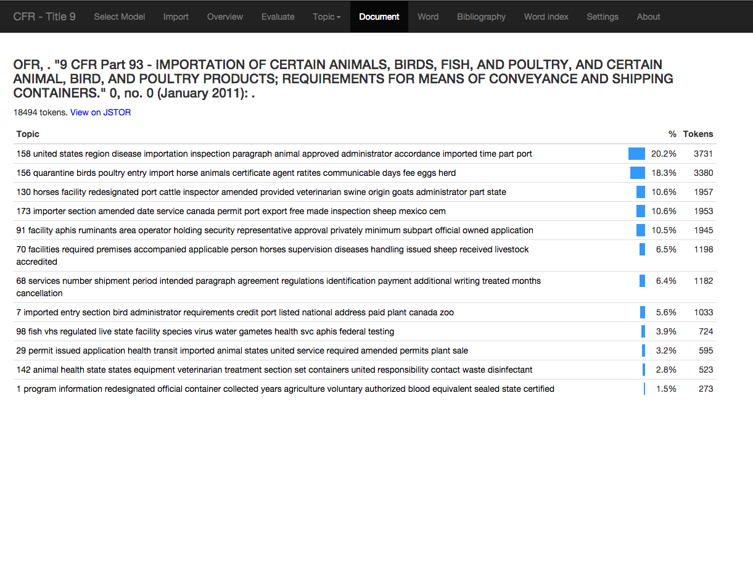
Visualizer: document view
Notes:
What is this document about?

Slide 17
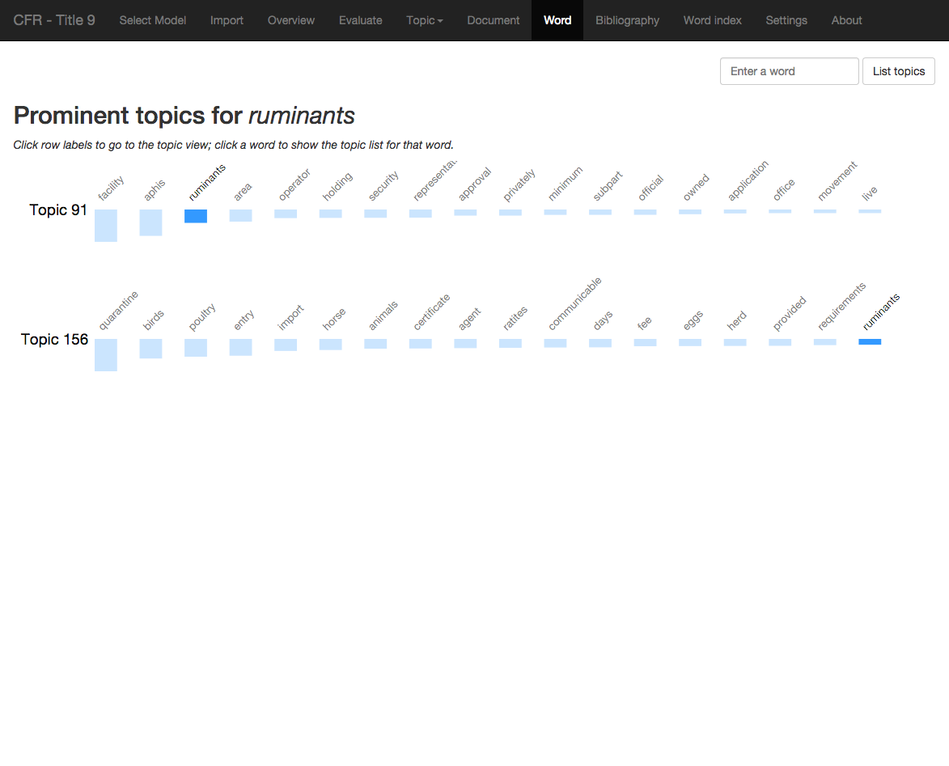
Visualizer: word view
Notes:
Word-sense disambiguation, phrasing

Slide 18
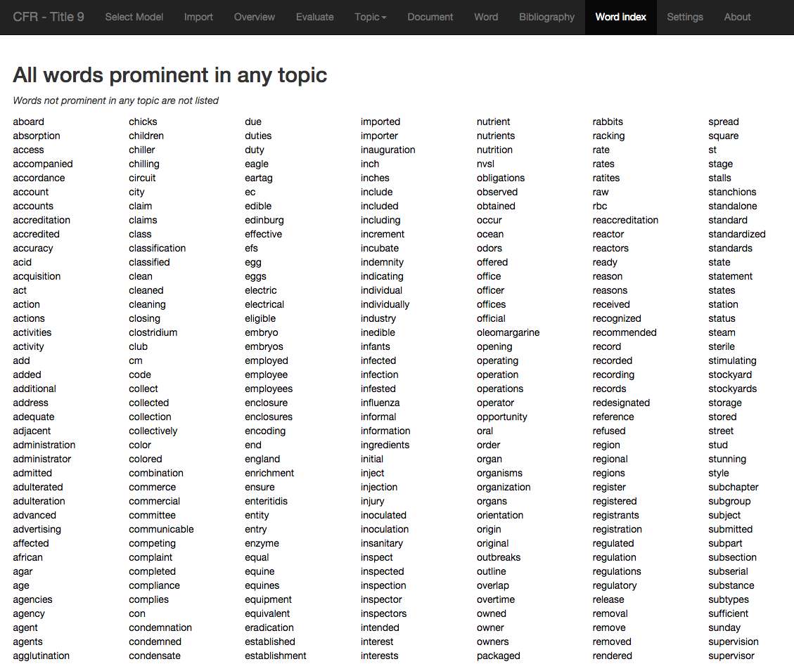
Visualizer: word list
Notes:
Stemming, lemmatization

Slide 19
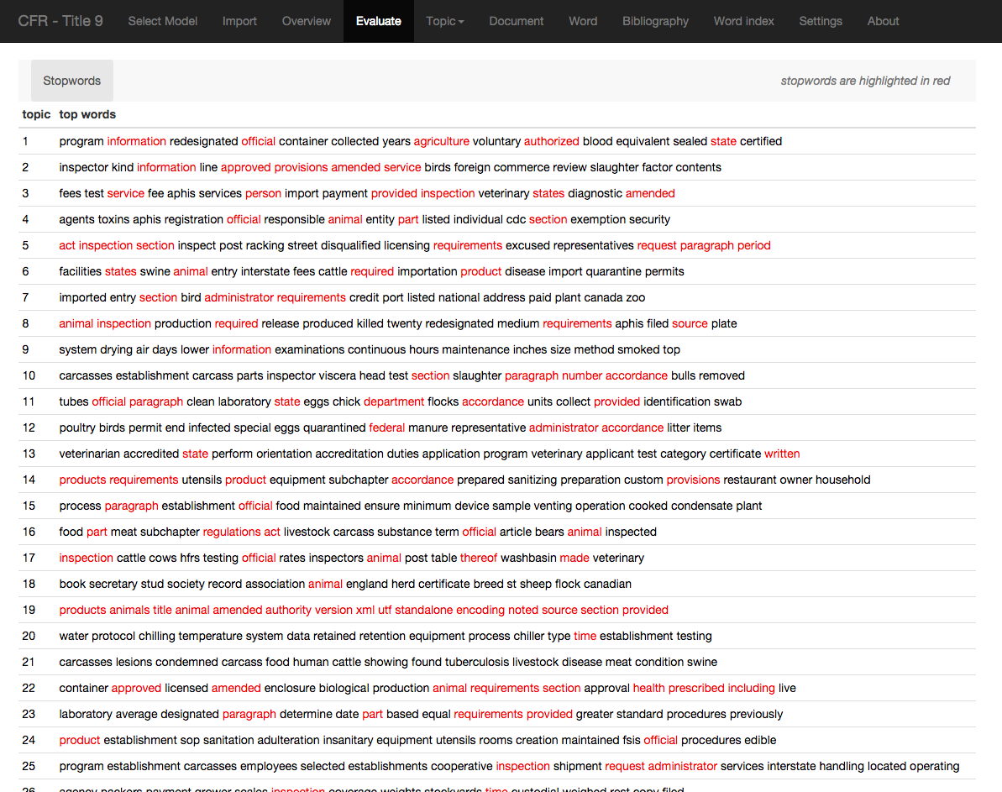
Visualizer: stopword evaluation
Notes:
This is done on the basis of term frequency; it could be adapted to incorporate machine learning; this will not help with intersecting discourses

Slide 20
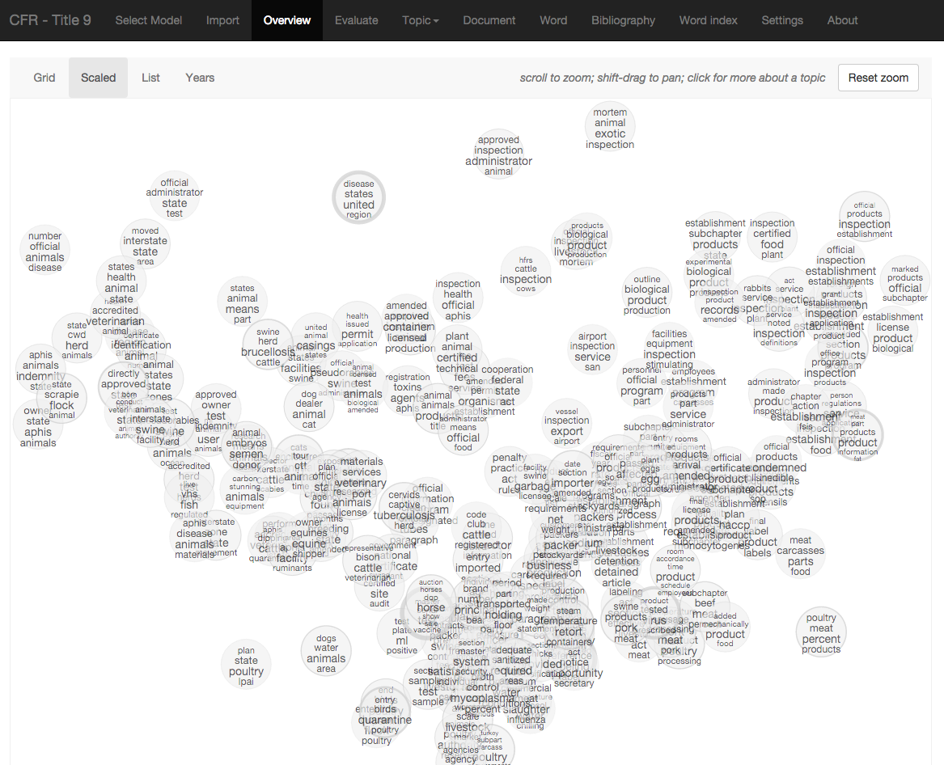
Visualizer: scaled view
Notes:
Clustering of concepts

Slide 21
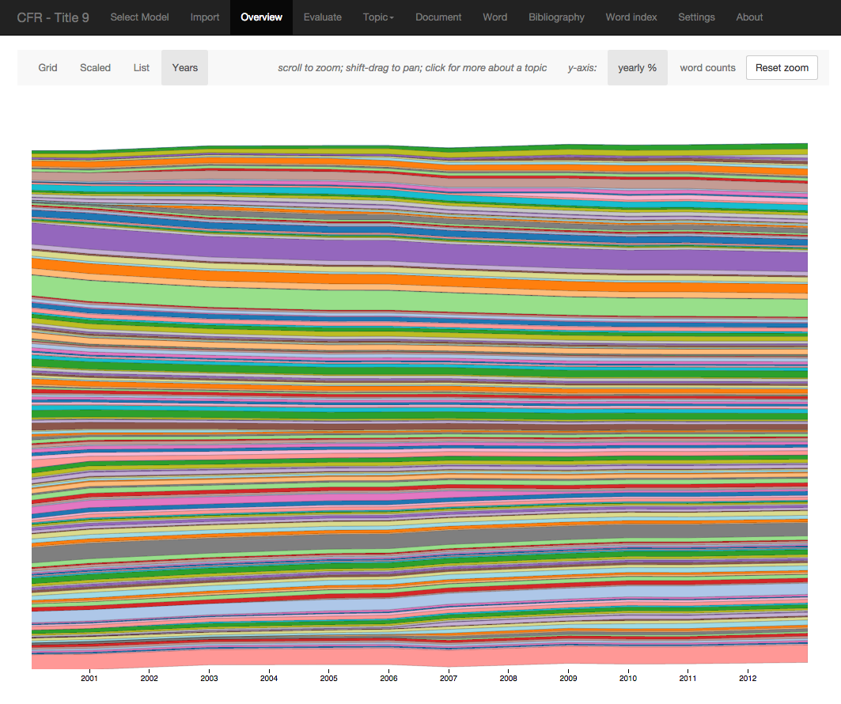
Visualizer: “years” view
Notes:
Stability of discourse over time

Slide 22
Things we’ve done
Categorization
caselaw, both general and bankruptcy
legal scholarship
Discourse comparison
State statutes
CFR temporal snapshots

Slide 23
A final example: the Magic 8-Ball
Inferencer… what’s that?
Trained on 25K cases from CourtListener
Actually, 19K because we cut all cases under 3K bytes.
500 topics.
“Site” implemented with JRuby, slightly hacked MALLET, Apache TIKA, and Tesseract (OCR) for input doc conversion
Examples: kickboxing, whales, and Rowe

Slide 24
Future work
Automated stopword-list construction
eg. by named-entity recognition
Automated labelling
Hierarchical topic models
Better visualizers

Slide 25
Us
sara@liicornell.org
tom@liicornell.org
THANKS!

Slide 26
Resource guide: explanations
Megan Brett’s really easy explanation for non-technical people
Blei article from Comm. of the ACM
More Greek symbols than you ever want to see: Latent Dirichlet Allocation explained by Wikipedia.

Slide 27
Resource guide: survey papers
David Blei’s page
David Mimno’s bibliography

Slide 28
Resource guide: tools
MALLET software tools for text mining
David Mimno’s blog
DFR browser

